Slide 1

Automatic Schedule Generator
Sulaimani Polytechnic University
Technical College of Informatics
Department of Information Technology
Presenters: Peshawa Muhammed & Hiran Fahmy
Supervised by: Khalid H. Ahmed
SPU|Technical College of Informatics

Slide 2
Overview
Introduction
Why Timetable Generator?
Tools and Techniques
Architecture Design
Conclusion
SPU|Technical College of Informatics
2

Slide 3
Introduction
Timetable creation is a very arduous and time consuming task. To create timetable it takes lots of patience and man hours.
We have tried to reduce these difficulties of generating timetable by Genetics Algorithm, By using this algorithm we are able to reduce the time require to generate time table and generate a timetable which is more accurate, precise and free of human errors.
SPU|Technical College of Informatics
3

Slide 4
Why Timetable Generator?
Generally, the hand operated system of time table preparation in colleges is very monotonous and time consuming which results in either the same teachers ending up with more than one class at a time or a number of classes conflicting at the same classroom.
SPU|Technical College of Informatics
4

Slide 5
Tools and Techniques
Microsoft Visual Studio for creating windows form application
C# for coding
SQL Server for Database Management System
Genetics Algorithm for generating timetable
SPU|Technical College of Informatics
5

Slide 6
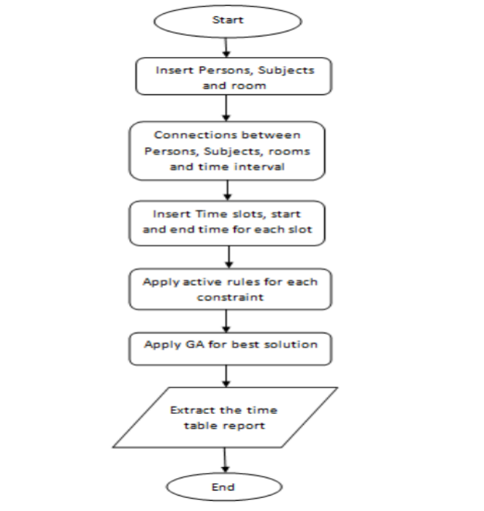
Architecture Design | Activity Diagram
SPU|Technical College of Informatics
6

Slide 7
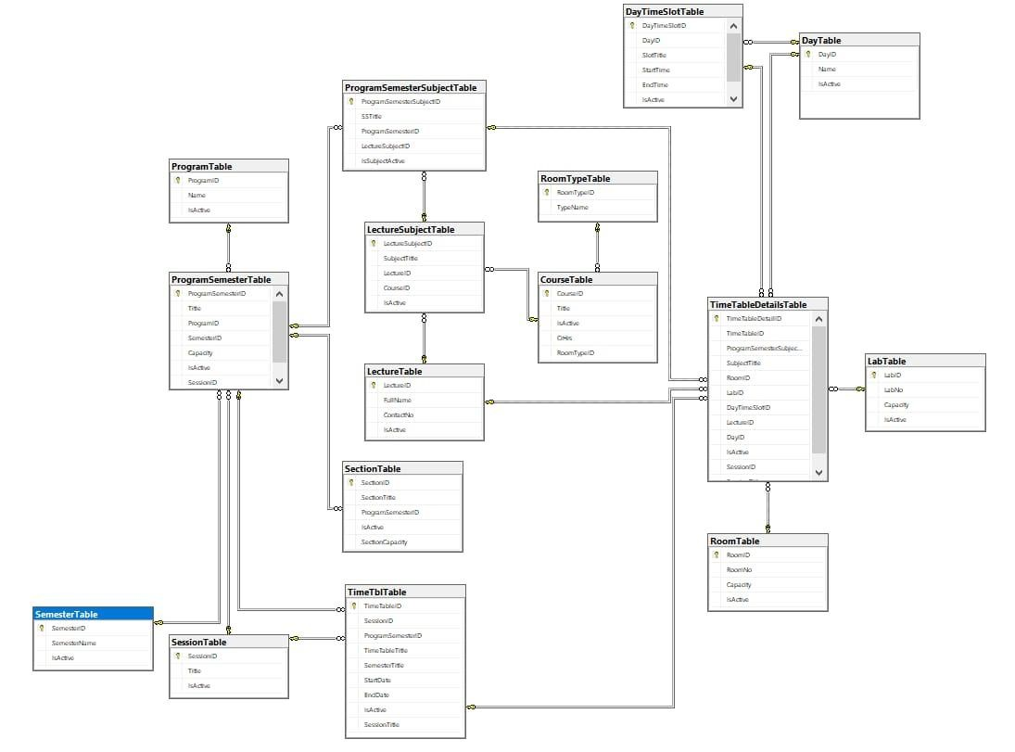
Architecture Design | ER-Diagram
SPU|Technical College of Informatics
7

Slide 8
Conclusion
Creating such timetables manually is a complex and time consuming process. By automating this process with computer assisted timetable generators can save a lot of precious time of administrators who are involved in creating and managing course timetables. Since every college has its own timetabling problem, the commercially available software packages may not suit the needs of every college. Hence we have developed a practical approach for building lecture course timetabling systems, which can be customized to fit most college's timetabling problem.
SPU|Technical College of Informatics
8

Slide 9
Thanks for your attention
Q and A?
SPU|Technical College of Informatics

